Slide 1
ECE 4115
Control Systems Lab 1
Spring 2005
Chapter 3
Frequency Domain Analysis and Design
Prepared by: Nisarg Mehta

Slide 2
Matlab
Start → Run → \\laser\apps
Open MatlabR14 and double click on MATLAB 7.0.1

Slide 3
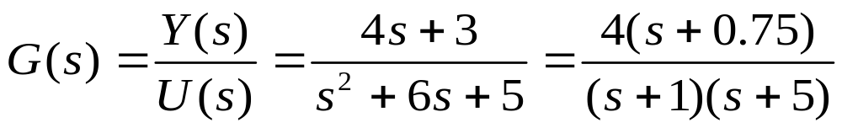
Summary of Chapter 1
System Models
4 basic types of LTI models
  Transfer Function: tf, tfdata
  Zero-pole-gain model: zpk, zpkdata
Conversion between models
Model dynamics

Slide 4
Summary of Chapter 2
Time Response of System
Impulse response: Impulse
Step response: Step
General time response: lsim
Polynomial multiplication: conv
Polynomial division: deconv
Partial fraction expansion: residue

Slide 5
Presentations
http://www.egr.uh.edu/courses/ECE/

Slide 6
Frequency Domain Analysis and Design
Root locus analysis
Frequency response plots
  Bode
  Nyquist
    Gain Margin
    Phase Margin

Slide 7
Root Locus
The root locus is a plot in the s-plane of all possible locations of the poles of a closed-loop system, as one parameter, usually the gain, is varied from 0 to ∞.
By examining that plot the designer can make choices of values of the controller’s parameters, and can infer the performance of the controlled closed-loop system.

Slide 8
Command rlocus
Command | Help
rlocus | Evans root locus. rlocus(sys) computes and plots the root locus of the SISO LTI model SYS. The root locus plot is used to analyze the negative feedback loop shown in the following Figure, and shows the trajectories of the closed-loop poles when the feedback gain K varies from 0 to Inf. RLOCUS automatically generates a set of positive gain values that produce a smooth plot.

Slide 9
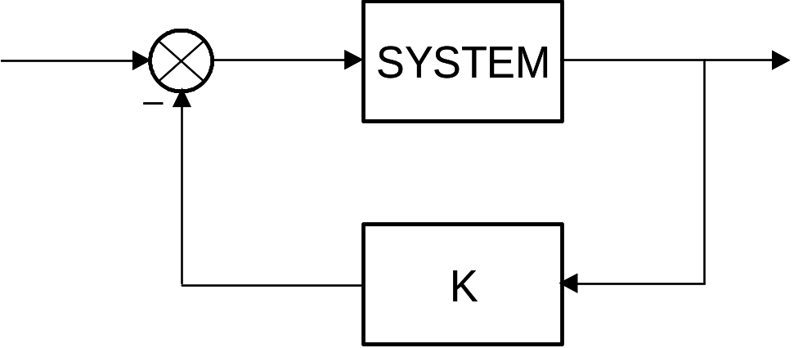
Command rlocus
Command | Help
rlocus (cont’d) | rlocus(sys,k) uses a user-specified vector K of gain values. [r,k]=rlocus(sys) or r=rlocus(sys,k) returns the matrix R of complex root locations for the gains K.

Slide 10
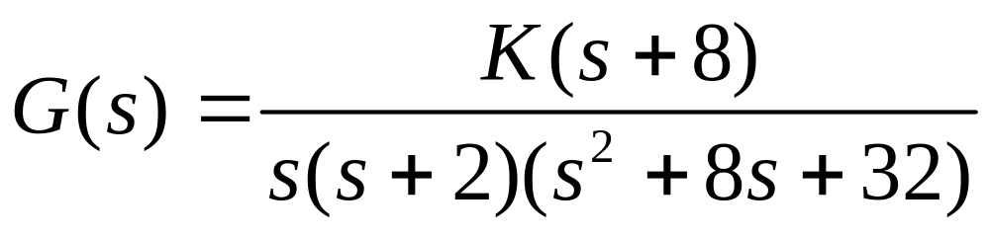
Problem 1
Plot the root locus of the following system

Slide 11
H:\ECE4115\Chp3\Chp3_1.m
  clear all
  close all
  clc
  num=[1 8];
  den=conv(conv([1 0],[1 2]),[1 8 32]);
  Gsys=tf(num,den)
  rlocus(Gsys)

Slide 12
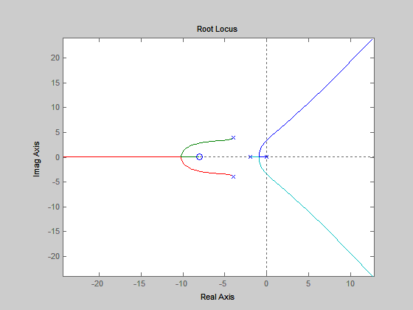
H:\ECE4115\Chp3\Chp3_1.m

Slide 13
Command rlocfind
Command | Help
rlocfind | Find root locus gains for a given set of roots. [k,poles]=rlocfind(sys) is used for interactive gain selection from the root locus plot of the SISO system sys generated by rlocus. rlocfind puts up a crosshair cursor in the graphics window which is used to select a pole location on an existing root locus. The root locus gain associated with this point is returned in K and all the system poles for this gain are returned in poles.

Slide 14
Command rlocfind
Command | Help
rlocfind (cont’d) | [k,poles]=rlocfind(sys,p) takes a vector p of desired root locations and computes a root locus gain for each of these locations (i.e., a gain for which one of the closed-loop roots is near the desired location). The j-th entry of the vector K gives the computed gain for the location p(j), and the j-th column of the matrix poles lists the resulting closed-loop poles.

Slide 15
Problem 1
Plot the root locus of the following system

Slide 16
H:\ECE4115\Chp3\Chp3_1.m
  clear all
  close all
  clc
  num=[1 8];
  den=conv(conv([1 0],[1 2]),[1 8 32]);
  Gsys=tf(num,den)
  rlocus(Gsys)
  [k,pol]=rlocfind(Gsys)

Slide 17
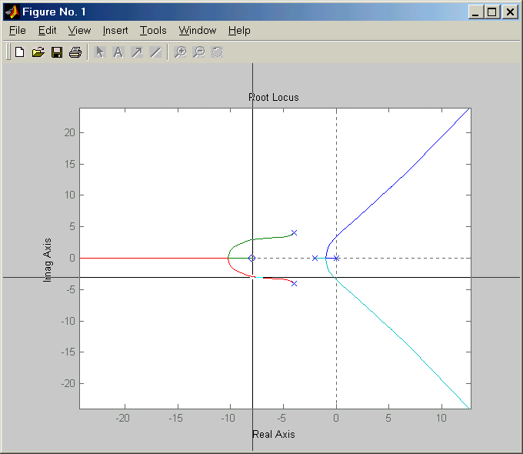
H:\ECE4115\Chp3\Chp3_1.m

Slide 18
H:\ECE4115\Chp3\Chp3_1.m
Transfer function:
s + 8
----------------------------
s^4 + 10 s^3 + 48 s^2 + 64 s
Select a point in the graphics window
selected_point =
-8.2929 - 2.7551i
k =
775.1330
pol =
3.2999 + 8.3727i
3.2999 - 8.3727i
-8.2999 + 2.7705i
-8.2999 - 2.7705i

Slide 19
Frequency Response Plots
Bode and Nyquist
Typically, the analysis and design of a control system requires an examination of its frequency response over a range of frequencies of interest.
The MATLAB Control System Toolbox provides functions to generate two of the most common frequency response plots: Bode Plot (bode command) and Nyquist Plot (nyquist command).

Slide 20
Bode and Nyquist Plot
Command | Help
logspace | Logarithmically spaced vector. logspace(d1,d2) generates a row vector of 50 logarithmically equally spaced points between decades and . logspace(d1,d2,N) generates N points.

Slide 21
Logspace
Plot 100 points from 0.1 to 100 which are logarithmically equidistant
>> t = logspace(-1,2,100)
>> plot(t,’.’)

Slide 22
Bode Plot
Command | Help
bode | Bode frequency response of LTI models. bode(sys) draws the Bode plot of the LTI model SYS (created with either tf, zpk or ss). The frequency range and number of points are chosen automatically. bode(sys,{wmin,wmax}) draws the Bode plot for frequencies between wmin and wmax (in radians/second).

Slide 23
Bode Plot
Command | Help
bode (cont’d) | bode(sys,w) uses the user-supplied vector w of frequencies, in radian/second, at which the Bode response is to be evaluated. See logspace to generate logarithmically spaced frequency vectors. [mag,phase]=bode(sys,w)and[mag,phase,w]=bode(sys) return the response magnitudes and phases in degrees (along with the frequency vector w if unspecified). No plot is drawn on the screen. If sys has NY outputs and NU inputs, MAG and PHASE are arrays of size [NY NU LENGTH(W)].

Slide 24
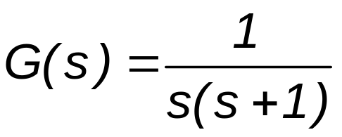
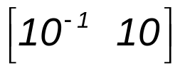
Problem 2
Given the LTI system
Draw the Bode diagram for 100 values of frequency in the interval .

Slide 25
H:\ECE4115\Chp3\Chp3_2.m
  clear all
  close all
  clc
  A=[1];
  B=[1 1 0];
  w=logspace(-1,1,100);
  sys=tf(A,B);
  bode(sys,w);

Slide 26
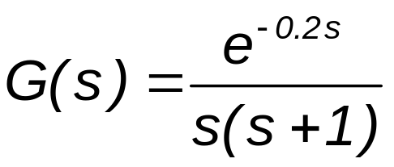
Problem 2
Given the LTI system
Draw the Bode diagram for 100 values of frequency in the interval .

Slide 27
H:\ECE4115\Chp3\Chp3_2.m
  clear all
  close all
  clc
  A=[1];
  B=[1 1 0];
  w=logspace(-1,1,100);
  sys=tf(A,B);
  bode(sys,w);
  [mag, phase] = bode(sys,w);

Slide 28
H:\ECE4115\Chp3\Chp3_2.m
for i=1:length(w)
magnitude(i)=mag(1,1,i);
phase_wolag(i)=phase(1,1,i);
end
magdB=20*log10(magnitude);
phase_wlag=-57.3*0.2.*w;
phase_total=phase_wolag+phase_wlag;
figure;
subplot(2,1,1),semilogx(w,magdB)
subplot(2,1,2),semilogx(w,phase_wlag)

Slide 29
Nyquist Plot
Command | Help
nyquist | Nyquist frequency response of LTI models. nyquist(sys) draws the Nyquist plot of the LTI model SYS (created with either tf, zpk or ss). The frequency range and number of points are chosen automatically. nyquist(sys,{wmin,wmax}) draws the Nyquist plot for frequencies between wmin and wmax (in radians/second).

Slide 30
Nyquist Plot
Command | Help
nyquist (cont’d) | nyquist(sys,w) uses the user-supplied vector w of frequencies, in radian/second, at which the Nyquist response is to be evaluated. See logspace to generate logarithmically spaced frequency vectors. [re,im]=nyquist(sys,w)and[re,im,w]=bode(sys) return the real parts re and imaginary parts re of the frequency response (along with the frequency vector w if unspecified). No plot is drawn on the screen.

Slide 31
Definition of Gain Margin and Phase Margin
The loop gain Transfer function L(s)
The gain margin is defined as the multiplicative amount that the magnitude of L(s) can be increased before the closed loop system goes unstable
Phase margin is defined as the amount of additional phase lag that can be associated with L(s) before the closed-loop system goes unstable

Slide 32
Gain and Phase margin
Command | Help
margin | Gain and phase margins and crossover frequencies. [Gm,Pm,Wcg,Wcp] = MARGIN(sys) computes the gain margin Gm, the phase margin Pm, and the associated frequencies Wcg and Wcp, for the SISO open-loop model sys (continuous or discrete). The gain margin Gm is defined as 1/G where G is the gain at the -180 phase crossing. The phase margin Pm is in degrees.

Slide 33
Gain and Phase margin
Command | Help
margin (cont’d) | The gain margin in dB is derived by Gm_dB = 20*log10(Gm) The loop gain at Wcg can increase or decrease by this many dBs before losing stability, and Gm_dB<0 (Gm<1) means that stability is most sensitive to loop gain reduction. If there are several crossover points, MARGIN returns the smallest margins (gain margin nearest to 0 dB and phase margin nearest to 0 degrees).

Slide 34
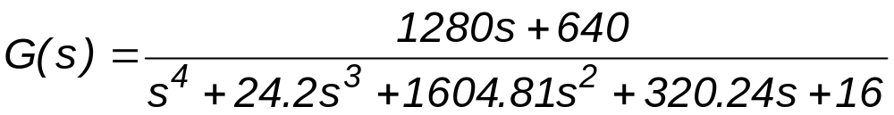
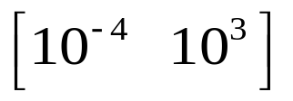
Problem 3
Given the LTI system
Draw the bode and nyquist plots for 100 values of frequencies in the interval
. In addition, find the gain and phase margins.

Slide 35
H:\ECE4115\Chp3\Chp3_3.m
clear all
close all
clc
A=[1280 640];
B=[1 24.2 1604.81 320.24 16];
w=logspace(-4,3,100);
sys=tf(A,B);

Slide 36
H:\ECE4115\Chp3\Chp3_3.m
%Bode plot
bode(sys,w)
gtext('(a)')
gtext('(b)')
[Gm,Pm,Wcg,Wcp]=margin(sys)
%Nyquist plot
figure
nyquist(sys,w)
axis([-10 50 -30 30])

Slide 37
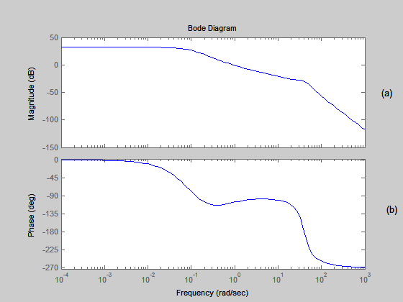
H:\ECE4115\Chp3\Chp3_3.m

Slide 38
H:\ECE4115\Chp3\Chp3_3.m
The values of gain and phase margin and corresponding frequencies are
Gm =
29.8637
Pm =
72.8960
Wcg =
39.9099
Wcp =
0.9036

Slide 39
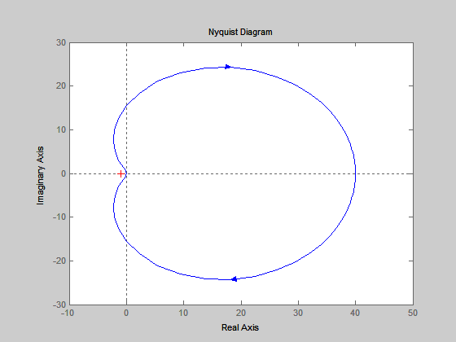
H:\ECE4115\Chp3\Chp3_3.m

Slide 40
Summary
Root locus analysis (rlocus, rlocfind)
Frequency response plots
  Bode (bode)
  Nyquist (nyquist)
    Gain Margin (margin)
    Phase Margin (margin)

Slide 41
Questions???
Next Class: April 15th ,2005
(HW3 due on April 20th)

